Slide 1
Customer Life Time Value
MFCS
Ajay Kaushik

Slide 2
Introduction
Mahindra First Choice Services (MFCS) is a company of Mahindra Group and is India’s leading chain of multi-brand car workshops with over 335+ workshops present in 267+ towns & 24 states. It has serviced over 10,50,000 cars. The company aims to establish countrywide network of over 400 workshops.
Mahindra would now like to leverage the data that they have and address the key issues they have. Read along to know how you can help them improve their business.

Slide 3
Dataset
Customer data: where the details of the customer like the car owned, state and place of residence, order type, etc are present. Data dimension is of 534000 Customer entries
Invoice data: where information related to customer visits and transactions are recorded, whether a customer as insurance claims, bifurcation of the amount paid, for what type of service did the customer came for, etc…
Material Inventory: where information related to what kind of service did the customer took and what kind of material was used to service, Labor information and the cost for the service, Plant and plant name where the customer took the service.

Slide 4
Mission
Identify Customers throughout country
Mahindra First Choice Services will be benefited in multiple ways. Knowing the ownership pattern targeted marketing campaigns could be carried out. Knowing the spending patterns services could be suited to the particular spending pattern.
Identify Order type when/which each state receives presently
Knowing order types, Mahindra can prepare their workshops and train their staff accordingly.
Identify Market size – Mahindra will know the various customer segments and target them for sales promotion or marketing activities.

Slide 5
Problem Definition
Geo-location Customer analysis like Car Make in States, are being serviced.
Find out patterns in data like ownership, spending behavior
Market Segmentation - dividing customers in homogenous groups based on different characteristics captured in data like their buying behavior in certain period of time, their value for business or how loyal they are toward business ?
Predict Customer Lifetime value –Based on Customer segments, predict the revenue that can be extracted from each segment over a life of the car -Regression/Time Series.

Slide 6
Solution Overview
Data Cleaning
Explore Data Visualization
Feature engineering
Customer Segmentation Metric
Build a model to predict Customer Life Time Value
Customer Retention Prediction

Slide 7
Data Visualization
Interactive Dashboard – Developed in Tableau trial version online software.
Below link is now suspended due to unlicensed software used.
https://prod-apnortheast-a.online.tableau.com/#/site/visualgraphcom/views/MFCS/MFCS_1?:iid=1
Please see attached PDF offline data visualization report.

Slide 8
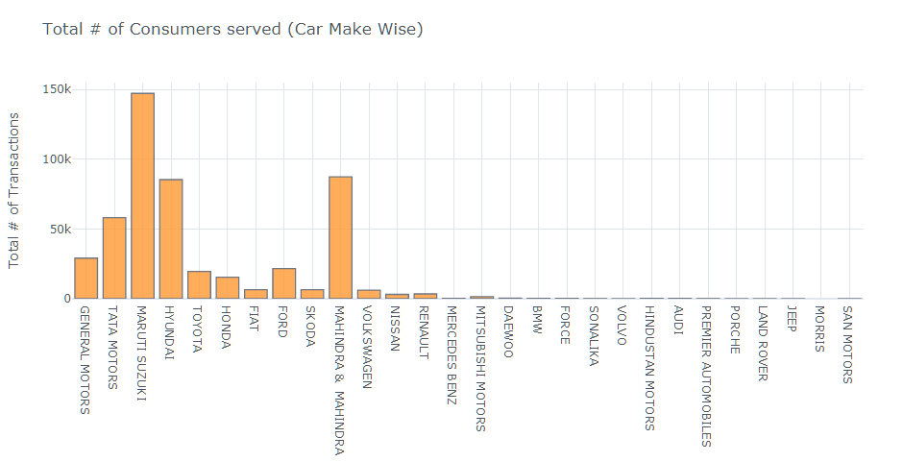
Consumers Car Make Wise

Slide 9
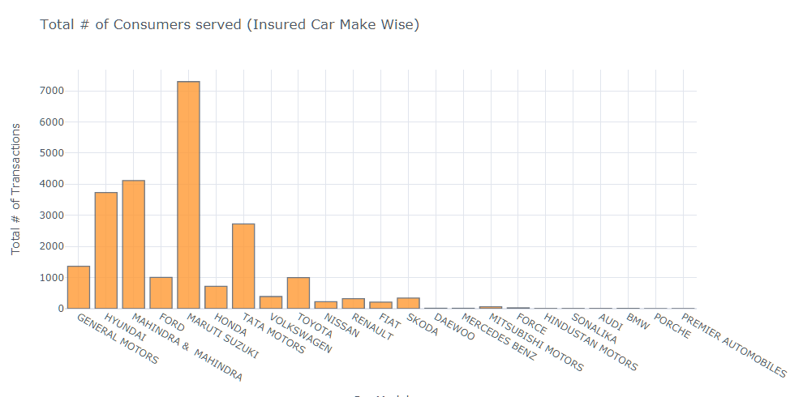
Insured Car Make Wise

Slide 10
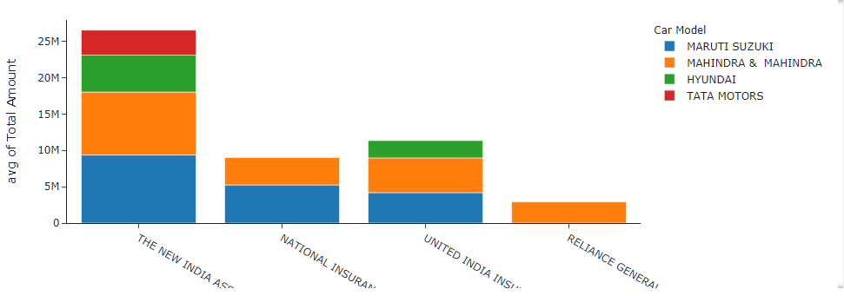
Insurance Company Vs Make

Slide 11
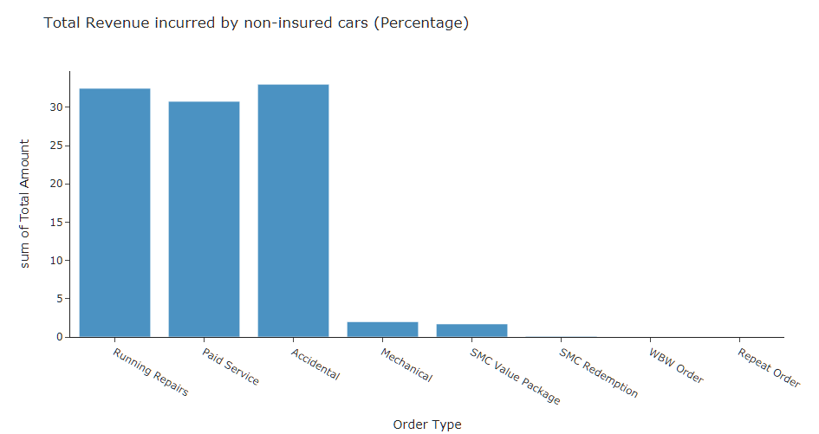
Revenue Trend by Service Type for insured car make

Slide 12
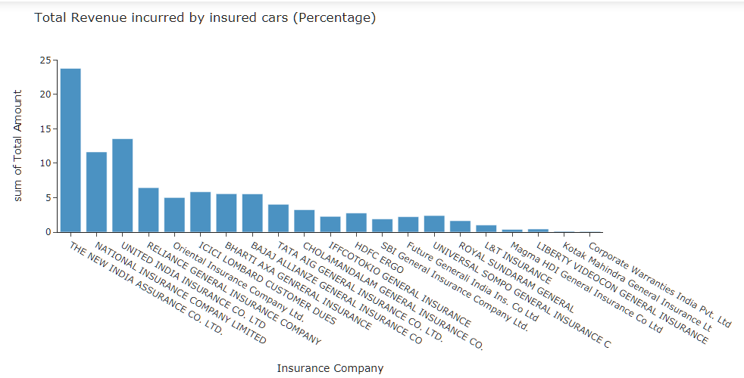
Revenue Trend by insured Car Make

Slide 13
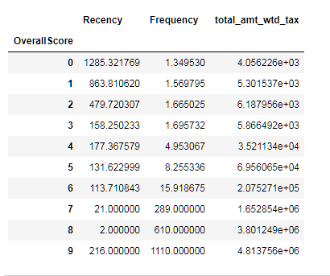
High level approach - RFM Model
Know the metric as per business domain.
Customer Segmentation
Build a model to predict CLV.

Slide 14
Steps involved in solving the problem
North Star Metric - It is single metric that best captures the core value that your product delivers to customers.
For example – For Facebook, it is daily active users.
In our example, we are using 2-3 yrs customer invoice dataset. For an invoice dataset, we can consider total revenue per month in workshop so our North Star metric is Monthly Revenue.

Slide 15
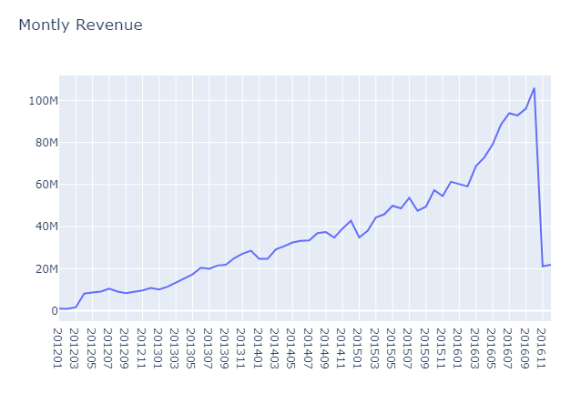
Monthly Revenue Trend
This clearly shows our revenue is growing
especially Feb ‘15 onwards
(and our data in December is incomplete).
Revenue =
Total Customer Count *
Order Count *
Average Revenue per Order

Slide 16
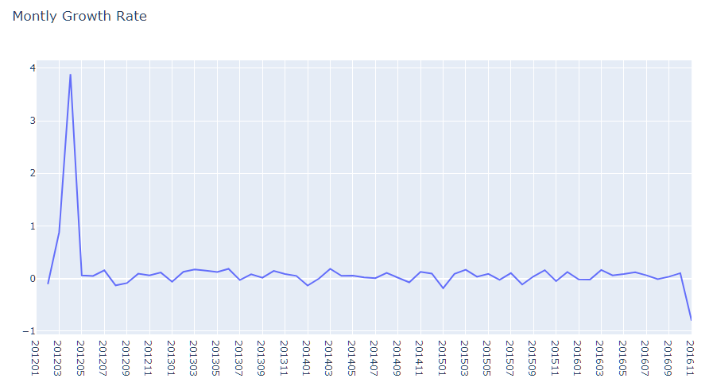
Monthly Revenue Growth Rate
Initially we had good growth, but why it went down after April,12, we need to look at that point.
Was there less active
Customers or we got less
Order ?
May be we started our
Business ?
Need Deep Analysis

Slide 17
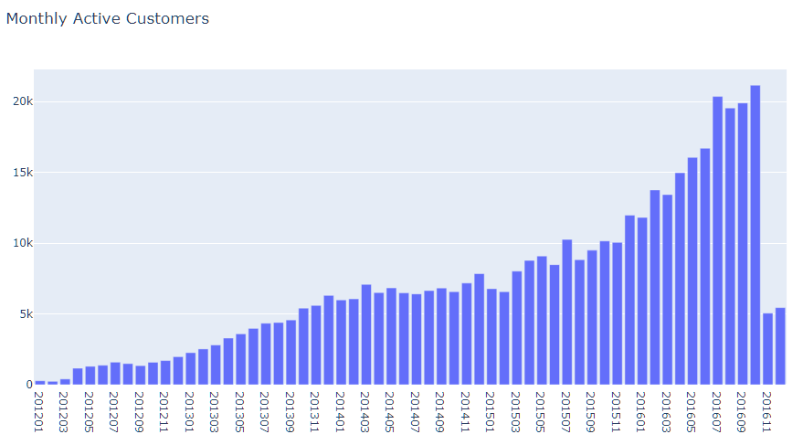
Monthly Active Customers
So initially we started our business and we had less active customer till April, 12.
It looks positive trend.

Slide 18
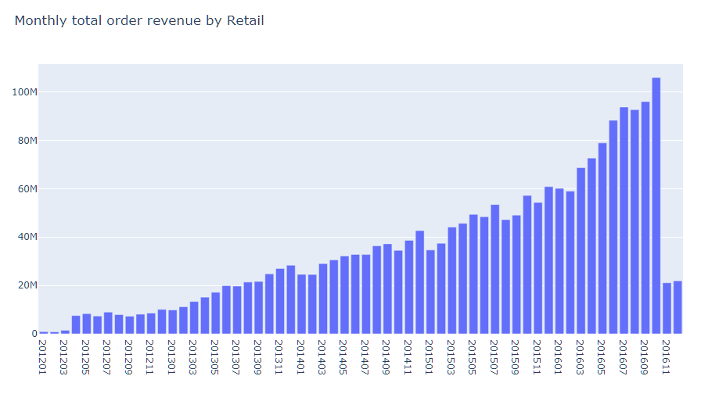
Monthly Total # of Order
So it is same trend as we have seen before.
Active Customer Count directly
affected Order Count decrease

Slide 19
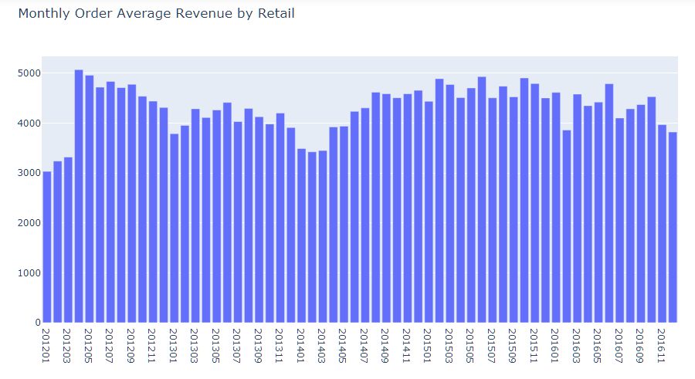
Monthly Average Order
Initially monthly order average also dropped before April,12.

Slide 20
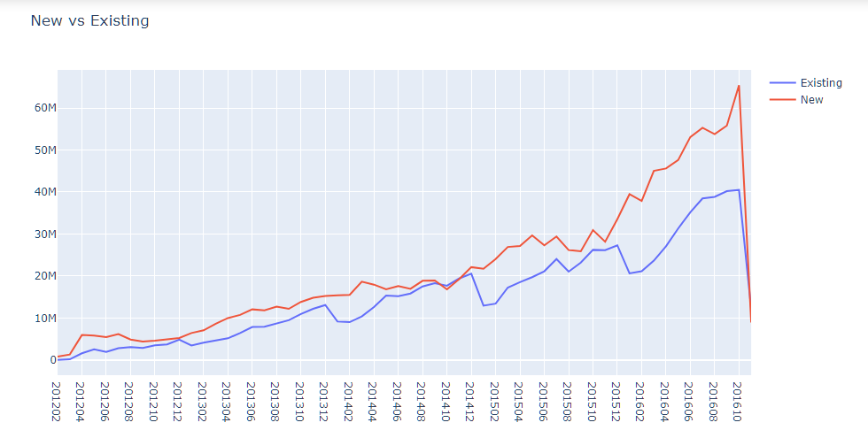
Customer Ratio Metric
New and Existing Customer are showing positive trend -

Slide 21
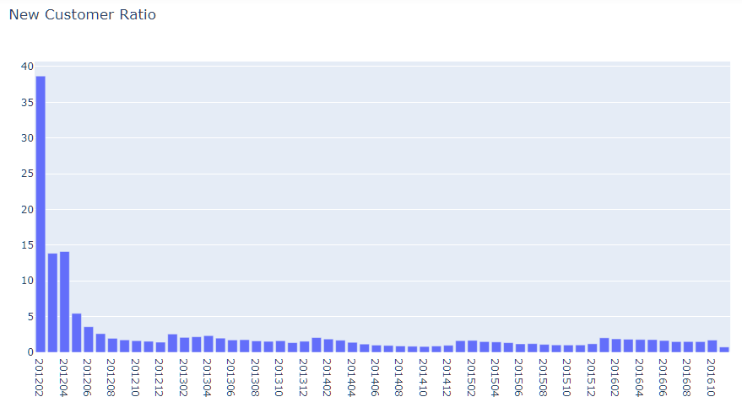
New Customer Ratio
A good indicator of if we
are losing our existing
customers or unable to
attract new ones.
New Customer Ratio
has declined as expected
(we assumed on April,2012,
all customers were New)
and running around 20%.

Slide 22
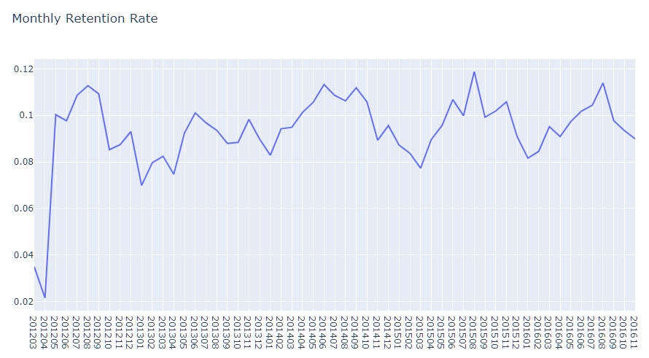
Monthly Retention Rate
King of the metrics.
Indicates how many customers
we retain over specific time
Window, it shows positive trend.
So how well your product fits the
Market .

Slide 23
RFM Analysis
RFM (recency, frequency, monetary) analysis is a marketing technique used to determine quantitatively which customers are the best ones by examining how recently a customer has purchased (recency), how often they purchase (frequency), and how much the customer spends (monetary).

Slide 24
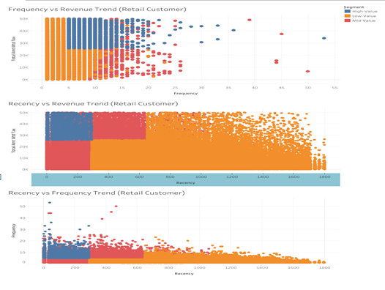

Slide 25
CLV
Why Is Customer Lifetime Value Important?
Customer Lifetime Value is simply the amount of money you make from a single paying user on your store during their lifetime of business with you
What goes into calculating Customer Lifetime Value?
There are 3 key metrics that Recapture uses for CLV. You can find them individually in your store’s data, but we track them for you. They are:
Average Order Value
Purchase Frequency
Customer Value

Slide 26
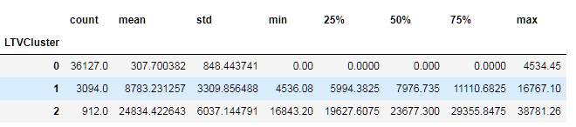
LTV Clusters
Define an appropriate time frame 6 months for Customer Lifetime Value calculation
Calculate lifetime value (LTV) for training the machine learning model
Using K-means algorithm, calculate 6 month revenue based on RFM of 3 months data
LTV cluster 2 is best with average 24.8k LTV whereas 0 is the worst with 307.

Slide 27
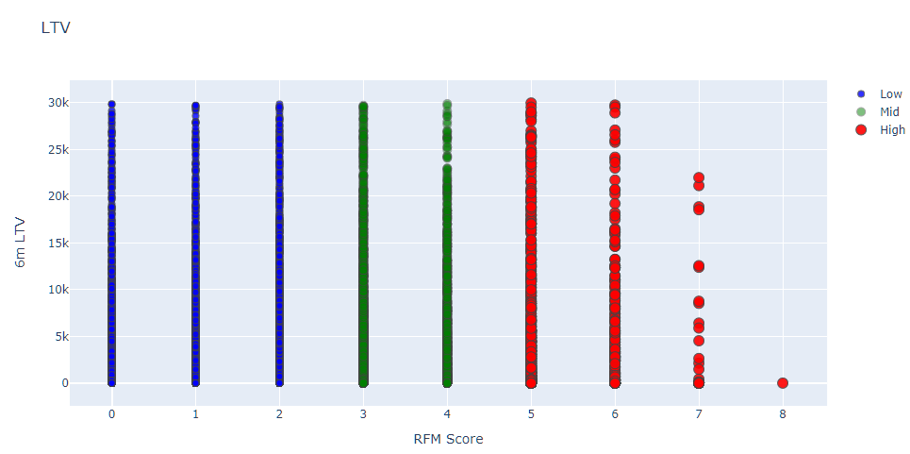
RFM Score
Positive correlation is visible here, High RFM score means high LTV.

Slide 28
Build Multi Class Classifier – XGB and SVM.
we have discovered tracking essential metrics, customer segmentation, and predicting the lifetime value programmatically
SVM classifier is able to predict small classes as well. We can see micro average score - 40% and macro average score - 39% for this model.
As per evaluating and problem, XGB Classifier is the our best model to predict each class - LTV cluster 0,1 and 2.
Average micro score for f1 - 0.6192849134172169
Average macro score for f1 - 0.34212866400473313
Average weighted score for f1 - 0.7046729549064478
XGB Classifier is a good model to predict each class equally in imbalance dataset.

Slide 29
Final Outcome
We are able to segment the customers -
Low Value , Mid Value, High Value
Predict LTV Model average f1-score – 70%
We can start taking actions with this segmentation. The main strategies are quite clear:
High Value: Improve Retention
Mid Value: Improve Retention + Increase Frequency
Low Value: Increase Frequency

Slide 30
Value delivered to business
Geo-location based analysis
Customer Segmentation
Predict LTV Model
Marketing strategies

Slide 31
Additional things that can be added (optional)
Recommendations -
Inventory management
Predicting Sales
Customer Churn Data
Software Tool -
Tableau Software used.
Jupyter notebook and Python libraries used.

